Slide 1
Client-Server Architecture

Slide 2

Introduction
The Client-Server Model is a distributed architecture where clients request services and servers provide them. It underpins many modern systems, including websites, email, and cloud storage platforms.

Slide 3
How Does the Client-Server Model Work?
Client: A client is any device or software that initiates communication by requesting data or services from a server. Common client applications include:
Web browsers (e.g., Chrome, Firefox)
Server: A server is a powerful systems that listens for and responds to client requests by delivering data or performing tasks. Servers often handle multiple simultaneous client requests. Common server applications include:
Web Servers (e.g., Apache, Nginx)

Slide 4
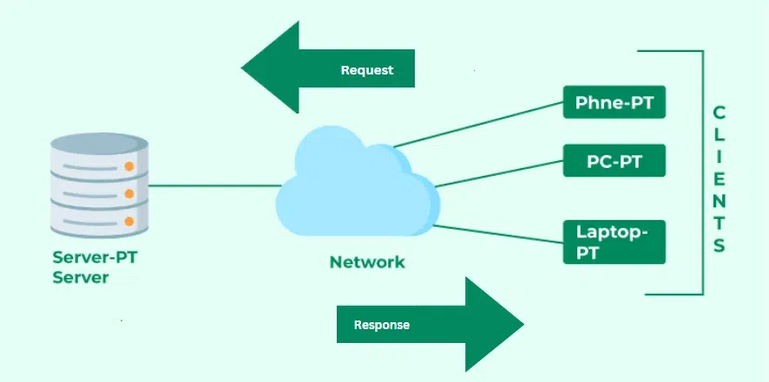

Slide 5
How the Browser Interacts With the Servers?
User Enters the URL (Uniform Resource Locator)
DNS (Domain Name System) Lookup
Establishing a Connection
Server Responds
Browser Renders the Webpage
DOM interpreter: CSS interpreter
JavaScript Engine

Slide 6
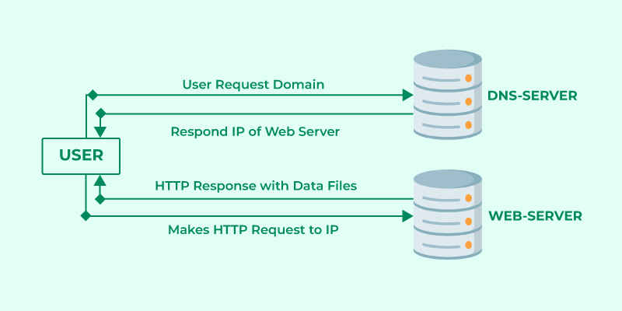

Slide 7
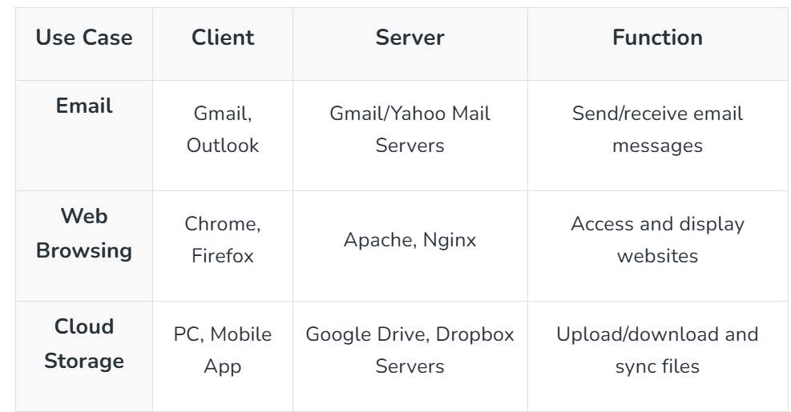
Examples of the Client-Server Model

Slide 8
Advantages of the Client-Server Model
Centralized Data Management
Cost Efficiency
Scalability
Security
Data Recovery

Slide 9
Disadvantages of Client-Server Model
Client Vulnerability
Server as a Target
Data Spoofing
MITM Attacks

Slide 10
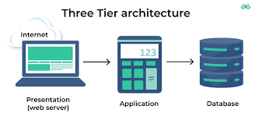
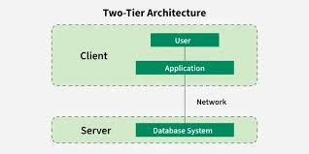
Types of Client-Server Architecture
Two-Tier Architecture
Three-Tier Architecture

Slide 11
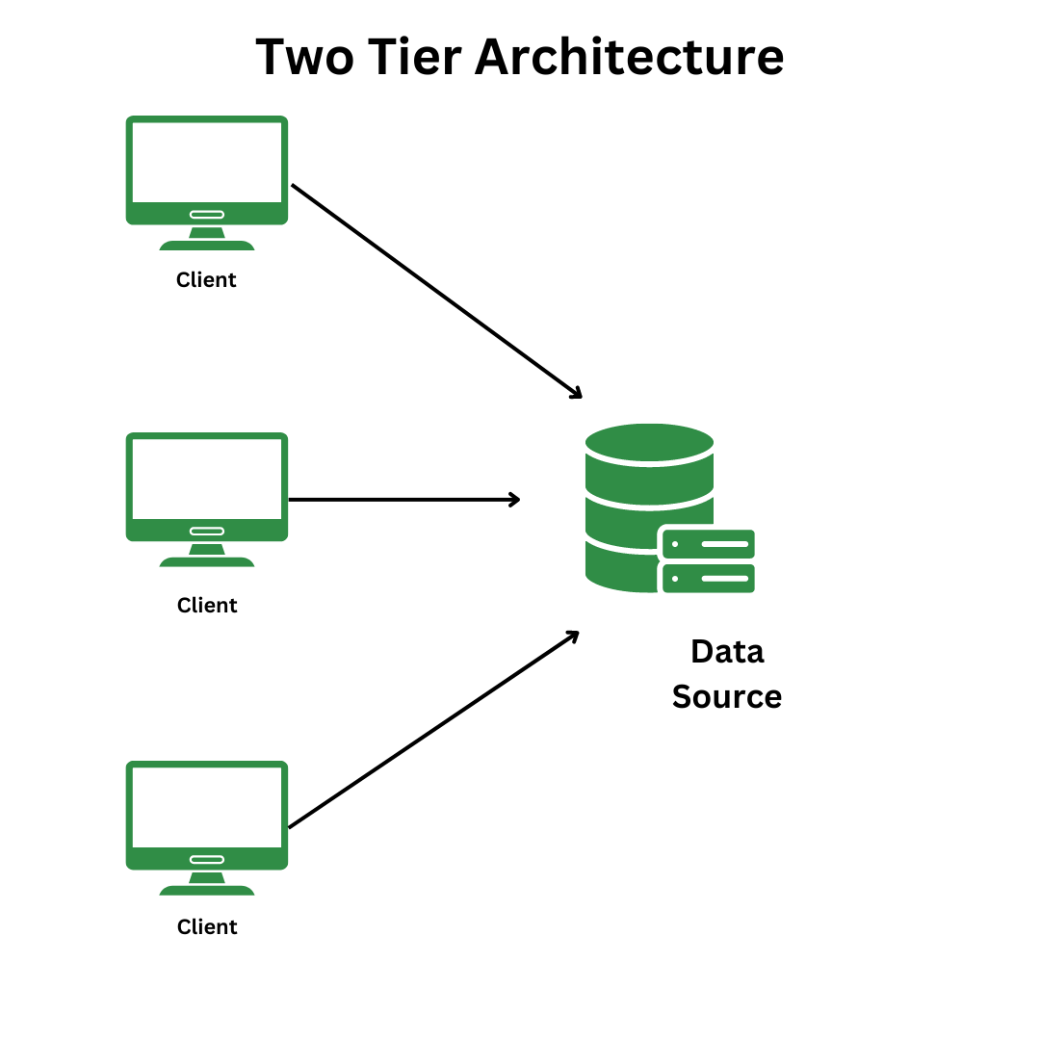
Two-Tier Architecture
In two-tier, the application logic is either buried inside the User Interface on the client or within the database on the server (or both). With two-tier client/server architectures, the user system interface is usually located in the user's desktop environment and the database management services are usually in a server that is a more powerful machine that services many clients.

Slide 12
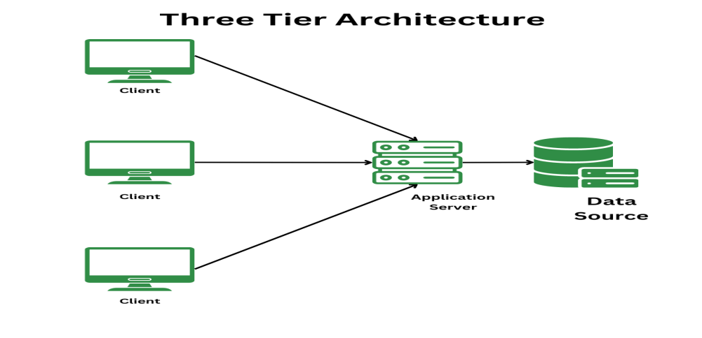
Three-Tier Architecture
In the three-tier, the application logic or process lives in the middle tier, it is separated from the data and the user interface. Three-tier systems are more scalable, robust and flexible. In the three-tier architecture, a middle tier was added between the user system interface client environment and the database management server environment. There are a variety of ways of implementing this middle tier, such as transaction processing monitors, message servers, or application servers.

